Slide 1
summative oral presentation Problem D: Multiple nutrient sensing for smart agriculture
Group:
T12
Members:
Chieh-Yin, Lee
Shu-Shan, Chiang
Yexi, Li
Yichi, Liu
Notes:
A-Joyce
15s
Hello everyone, we're team 12, our topic is Problem D: Multiple nutrient sensing for smart agriculture
And here are our team members: I'm Chieh-Yin Lee. And this is 書珊chaing, each liu, 燁熙 li.

Slide 2




Introduction
Potato Plants
Spectral Data
(400-2500 nm)
Machine Learning Model
Predicted Nutrient Levels
Collect reflectance data
High-dimensional reflectance data
PLSR with Ridge
Stacking model
Concentrations are estimated
Notes:
A
1 min(開場+Introduction)
也許可以改成我們後面報告的outline
大致介紹這整個專案，資料來源（馬鈴薯葉片反射資料）>整理、萃取成不同坡段高維度反射率資料>（我們團隊）對這些資料做machine learning，最終預估馬鈴薯的營養濃度（生長狀況）
Now, I'm going to briefly introduce our project. Our goal is to predict nutrient levels in potato plants using leaf reflectance data. The data contains wavelengths from 400 to 2500 nanometers, giving us high-dimensional spectral information. After preprocessing and feature extraction, we applied machine learning—specifically, combining PLS and Ridge in a stacking model.—to estimate nutrient concentrations such as nitrogen, phosphorus, and potassium.

Slide 3
Literature Background
NIRS for Nutrient Prediction
NIRS enables rapid, non-destructive crop nutrient assessment.
Abukmeil et al., 2022: Lasso Regression, RPD
Importance of Multi-Target Regression
Predicting nutrients together improves accuracy.
Rauschenberger & Glaab et al, 2021: Stacked Ridge/Lasso models.
Dimensionality Reduction and its Challenge
Multivariate regression models often include too many features and it can risk overfitting.
Dimensionality Reduction Method:
PLS (Burnett et al., 2022)
PCA (Jafarbiglu et al., 2022)
Challenge: feature interpretation and relationships are lost (Senawi et al., 2017).
Notes:
A
30 sec
Many recent studies have used near-infrared spectroscopy to estimate plant nutrients non-destructively. For example, Abukmeil used Lasso regression to identify key spectral bands for nutrients like nitrogen and phosphorus.
Instead of predicting one nutrient at a time, some researchers highlighted the value of multi-output regression, especially for correlated elements.
And since our spectral data is high-dimensional, we need dimensionality reduction. Compared to PCA, PLS works better in our case because it takes the outputs into account during transformation.
#Building on these foundations, we applied PLS and Ridge in a stacked model tailored to our dataset
1min:
精简:Recent studies have used NIRS to non-destructively estimate plant nutrients. For instance, Abukmeil applied Lasso regression to identify key spectral bands for nutrients like nitrogen and phosphorus. Rather than predicting nutrients individually, Rauschenberger and Glaab highlighted multi-output regression's importance, especially for correlated elements. In high-dimensional spectral data, dimensionality reduction is crucial. Compared to PCA, Partial Least Squares (PLS) regression is preferred as it incorporates output information during transformation, making it more effective. Building on this, we applied a stacked model combining PLS and Ridge regression tailored to our dataset.

Slide 4
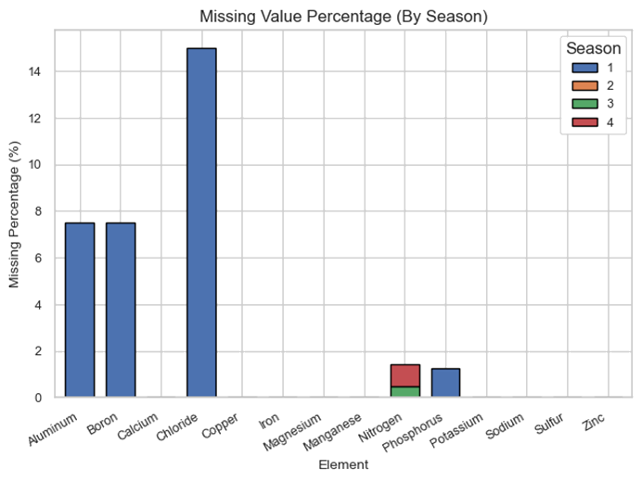
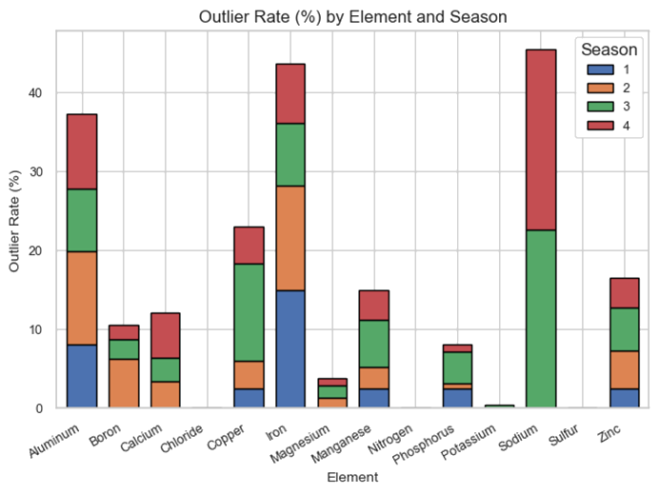
Understand the Data
Statistics for Missing Values and Outliers
Understand the Data
Data Preprocessing
Model Selection and Training
Validation Results
Missing Values
Outliers
Notes:
B- Susan
30 sec
In this stage, we conduct an analysis for missing values and outliers. The chart on the left indicates that Chloride has the highest proportion of missing data, primarily in Season 1. Meanwhile, the chart on the right reveals significant outlier rates in elements such as Alumninum, Iron and Sodium, particularly during Seasons 3 and 4.

Slide 5
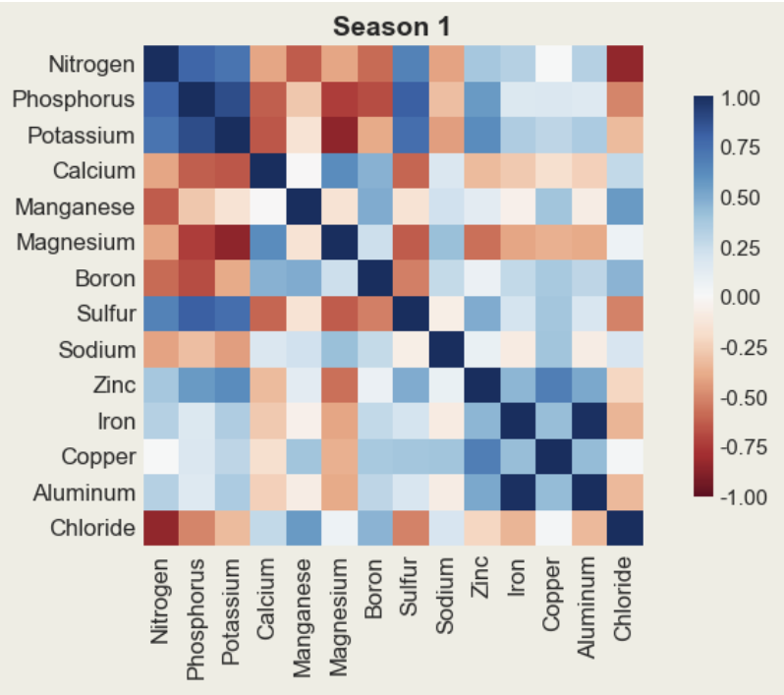
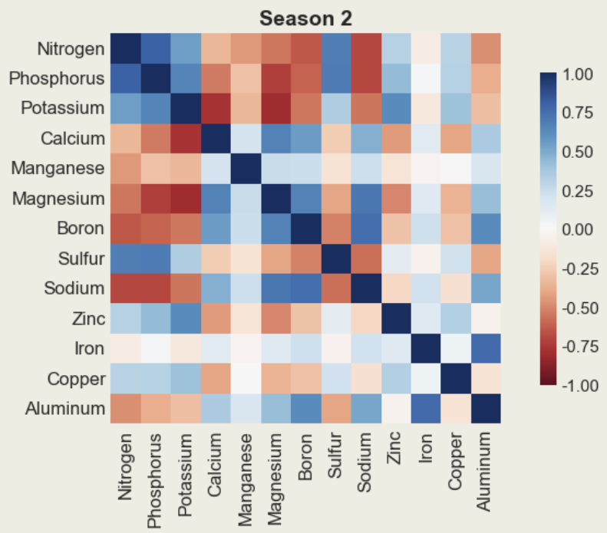
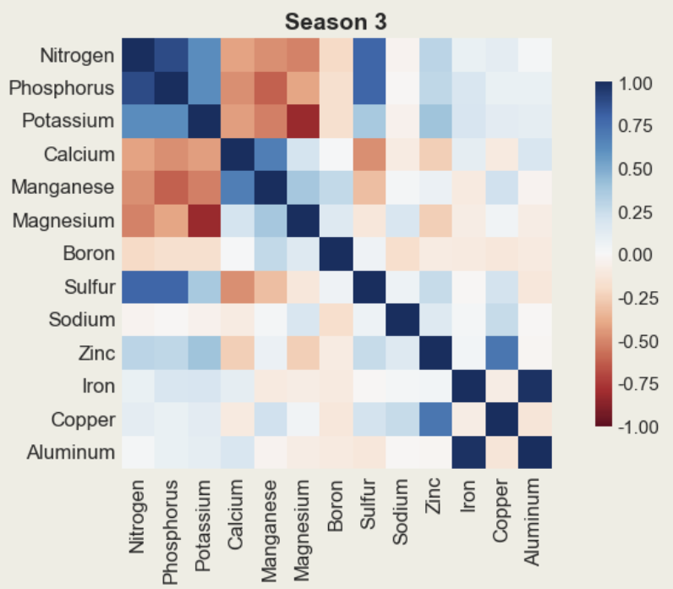
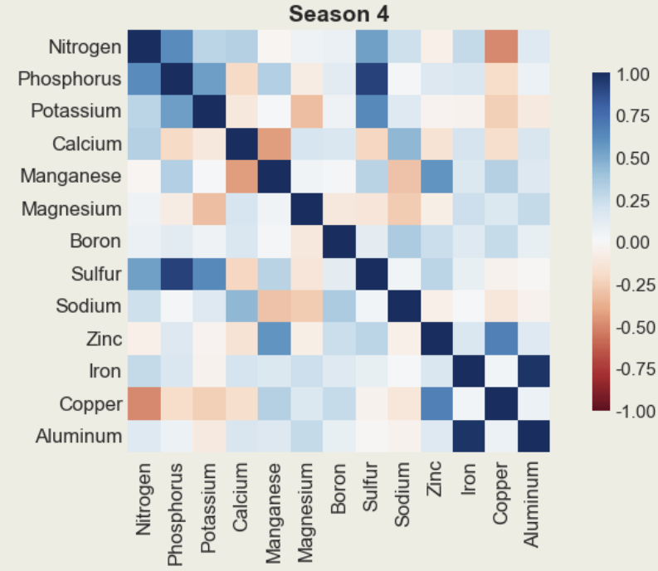
Understand the Data
Correlations of different Nutrients across seasons
Understand the Data
Data Preprocessing
Model Selection and Training
Validation Results
Element correlations vary across different seasons.
Some elements(e.g., Nitrogen, Phosphorus, Potassium) maintain strong correlations in multiple seasons.
Element correlations differ by season, suggesting seasonal effects on inter-element relationships.
Notes:
B
30S
Next, we analysed how nutrients correlate with each other across different seasons by heatmap.
X In these heatmap, darker colors indicate stronger correlations. Blue represents positive correlations, while red represents negative correlations.
As you can see, most nutrients show strong correlations with each other in seasons 1 and 2, particularly in key elements like Nitrogen, Phosphorus, and Potassium. However, these correlations weaken in seasons 3 and 4.
These results highlight the influence of seasonal factors on nutrient correlations.

Slide 6
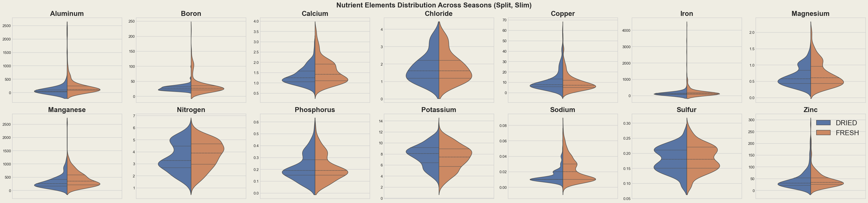
Understand the Data
Nutrient Elements Distribution Across Seasons
Understand the Data
Data Preprocessing
Model Selection and Training
Validation Results
Most nutrient elements show similar distributions between dried and fresh samples.
Boron and sodium exhibit some distribution differences across sample types.
Aluminum, iron, and manganese display heavy right tails due to extreme high values.
Notes:
B
30s
In this section, we analyse the distribution of nutrient elements for both dried and fresh samples. As illustrated in the violin plots, most elements exhibit similar distribution patterns in two sample types. However, notable differences are observed in Boron and Sodium. Additionally, elements such as Aluminum, Iron, and Manganese show heavy right-tailed distributions, indicating the presence of extreme high values. These characteristics are important to consider before proceeding with normalization and model training.
(X)This slide shows the distribution of different nutrient elements across dried and fresh samples. Most elements have similar distributions between the two sample types, but there are some differences, particularly for Boron and Sodium. Additionally, Aluminum, Iron, and Manganese show heavy right tails, indicating the presence of extreme high values. These patterns can help us understand how each nutrient behaves in different sample types.”
Revise>>>
Compared models: Ridge, Lasso, RF, SVR, PLS.
Final model: Stacking PLS + Ridge Regression.
Training details:
Weighted loss (focus on N, P, K).
5-fold CV.
80:20 train-test split.
(Table of models with a tick mark on the final choice)

Slide 7
Data Preprocessing
Data Preprocessing Strategies
Understand the Data
Data Preprocessing
Model Selection and Training
Validation Results
Category | Condition / Variable | Method
Handling Missing Values | Wavelengths | KNN Imputation
 | Nutrients: Missing rate > 10% | KNN Imputation
 | Nutrients: Missing rate ≤ 10% | Median Imputation
Tackling Outliers | Upper bound: Q3 + 1.5 × IQR Lower bound: Q1 − 1.5 × IQR | Winsorisation
Notes:
B
30 secs
To address the missing values and outliers we identified in earlier stage, we applied tailored preprocessing strategies. For missing data, KNN imputation was used for wavelengths and for nutrient variables with more than 10% missing values, while median imputation was applied to those with less than or equal to 10% missing rate.
To mitigate the impact of extreme values, we employed Winsorisation, using the interquartile range method to cap outliers beyond the upper and lower bounds. These preprocessing steps ensure a more reliable and consistent dataset for subsequent modeling.

Slide 8
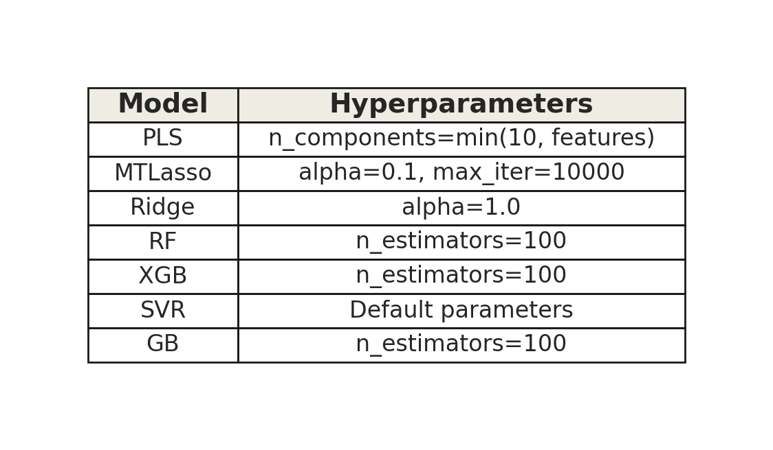
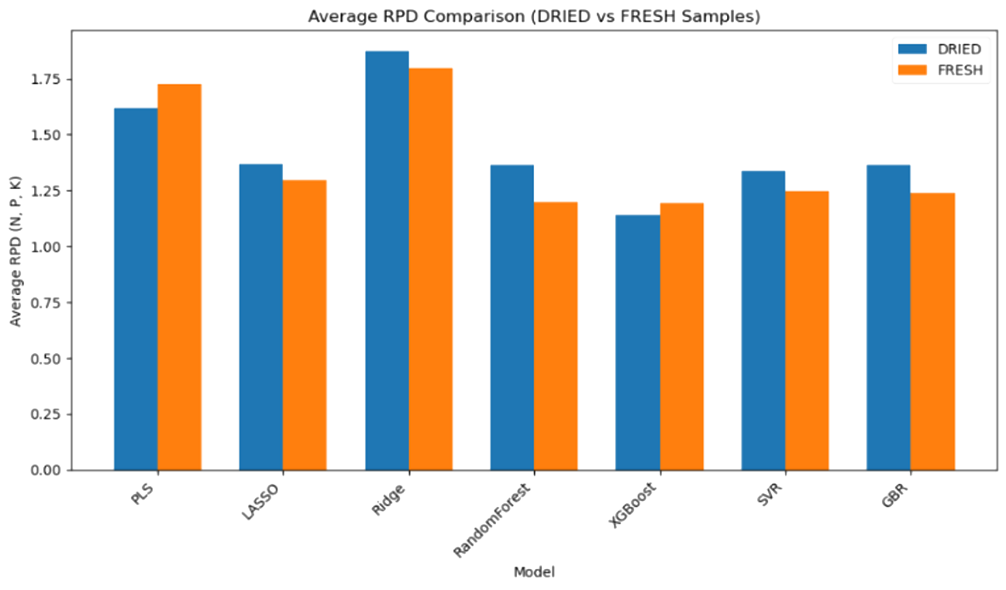
Model Selection and Training
Model Selection Strategies
Understand the Data
Data Preprocessing
Model Selection and Training
Validation Results
Experiment with different individual models
Basic Parameter Settings:
Criteria- RPD
Excellent (>2)
Acceptable (≥1.4–2.0)
Nonreliable (<1.40) (Mahajan et al., 2021)
Notes:
C- Yichi
60s沃野千
We compared seven different models: PLSR, MultiTaskLasso, Ridge, Random Forest, XGBoost, SVR, and Gradient Boosting.
Throughout this project, we used RPD as our main metric to evaluate model performance. The criteria we followed, shown in the bottom right corner (指一下右下角rpd部分) , are based on those used in previous research.
We compared the models based on their average RPD across nutrients, and the chart on the right-hand side (指一下右手邊的表格) also shows the hyperparameters we used for each model.
As you can see from the results, Ridge Regression and PLSR achieved higher average RPD values in both the Fresh and Dried datasets.
So we picked these 2 models to do further experiment and comparison.

Slide 9
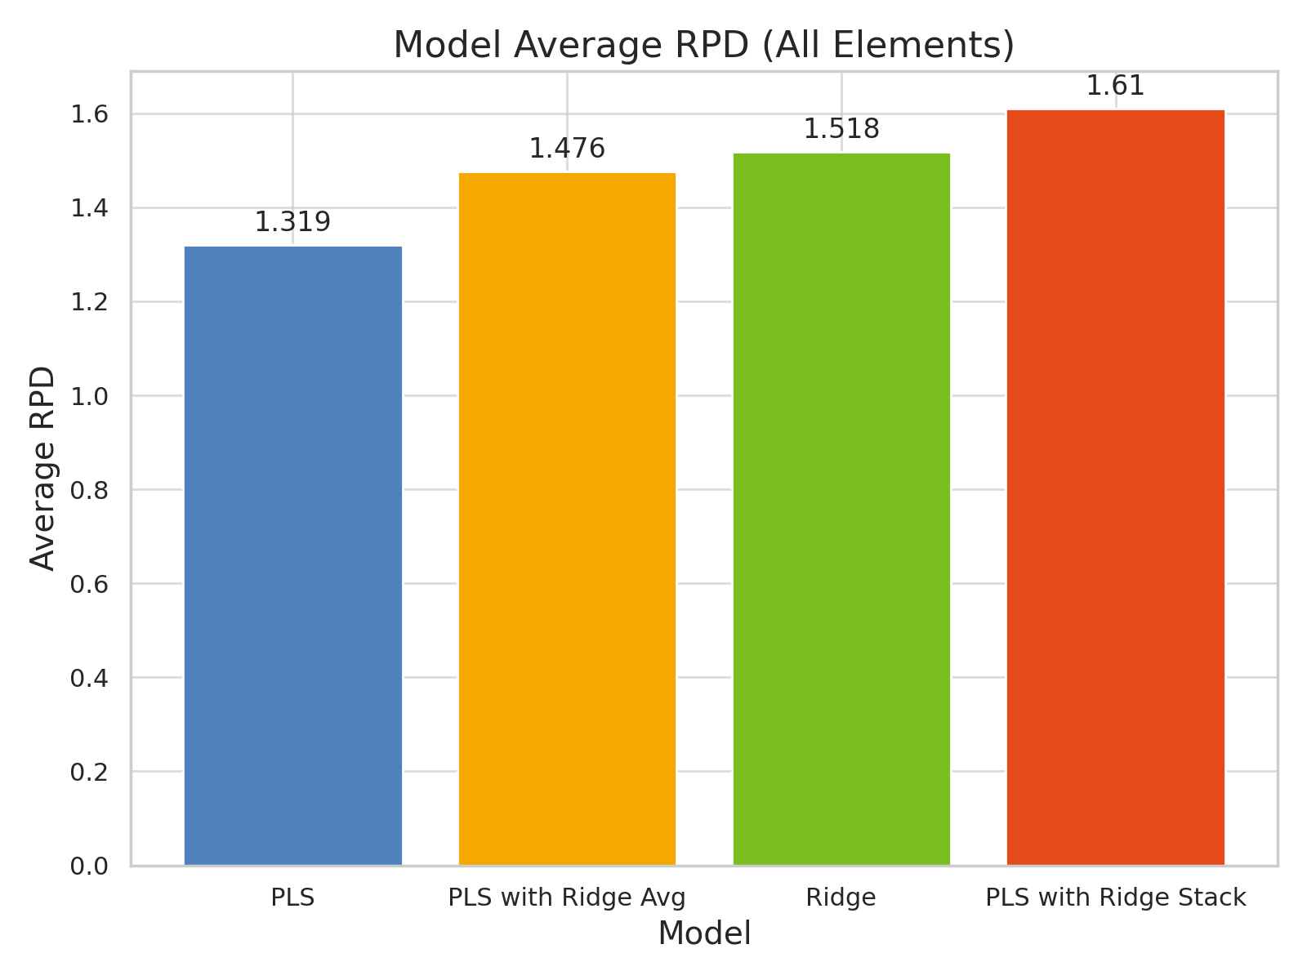
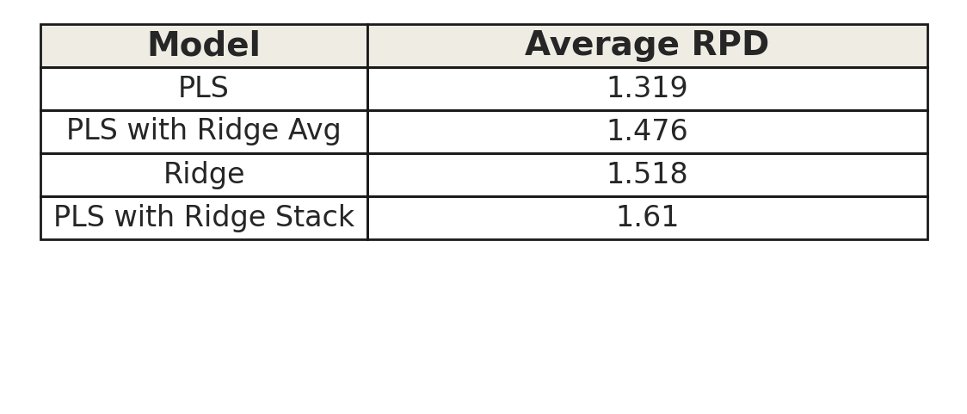

Model Selection and Training
Model Selection Strategies
Understand the Data
Data Preprocessing
Model Selection and Training
Validation Results
Experiment with different combined models (PLS and Ridge)
Indicator: RPD (Ratio of Prediction to Deviation)
The effect of PLS ​​alone is relatively general, but it can significantly improve the prediction performance by combining it with Ridge.
The stacking model can better extract information through more complex stacking learning
Best performance model : Stacking PLS + Ridge Regression
Indicator: RPD (Ratio of Prediction to Deviation)
Notes:
C- 60s
Revise>>>
Results: Cross-Season Generalisation
Problem: Models trained on one season perform poorly on others.
Evidence: Cross-Season Heatmap (small)
(Show heatmap here – very quick explanation)
So, to build a more robust and accurate model, we decided to combine their strengths using a stacking ensemble approach.
✨And that's how we came up with our final model: Stacked PLS + Ridge Regression. ✨

Slide 10
Validation Results
Results of Stacking PLS + Ridge Regression
Understand the Data
Data Preprocessing
Model Selection and Training
Validation Results
Result of DRIED_Season2(Best Season) and FRESH_Season3(Weakest Season)
 | Best Season: DRIED_season2 |  |  | Weakest Season: FRESH_season3
Element | RMSE | R2 | RPD | RMSE | R2 | RPD
Nitrogen | 0.1911 | 0.9544 | 4.7643 | 1.1621 | 0.0007 | 1.0250
Phosphorus | 0.0311 | 0.8385 | 2.5322 | 0.1173 | 0.0375 | 1.0445
Potassium | 0.9198 | 0.8506 | 2.6333 | 1.2123 | -0.0910 | 0.9810
Calcium | 0.2698 | 0.7746 | 2.1437 | 0.3263 | -0.2461 | 0.9180
Magnesium | 0.1809 | 0.8454 | 2.5882 | 0.1340 | 0.1477 | 1.1099
Sulfur | 0.0243 | 0.5181 | 1.4661 | 0.0408 | 0.0817 | 1.0693
Manganese | 158.4517 | 0.6055 | 1.6202 | 201.5272 | 0.3049 | 1.2291
Boron | 20.0762 | 0.7078 | 1.8827 | 2.9704 | 0.0793 | 1.0679
Zinc | 15.5049 | 0.4337 | 1.3523 | 13.6021 | 0.3257 | 1.2479
Iron | 114.9490 | 0.4380 | 1.3576 | 64.9423 | 0.0179 | 1.0340
Copper | 3.3949 | 0.4492 | 1.3713 | 7.8994 | 0.1085 | 1.0853
Aluminum | 80.6793 | 0.6849 | 1.8131 | 26.1917 | 0.0256 | 1.0381
Sodium | 0.0069 | 0.7961 | 2.2539 | 0.0000 | 1.0000 | NaN
Insights
Macronutrients (N, P, K) are generally well predicted across seasons
Micronutrients (e.g. B, Zn, Fe) remain difficult
→ often RPD < 1.5
Performance varies by season, possibly due to sample variability, data collection differences, or concept drift
Notes:
D- Yexi
60s
Revise>>>
Results: Cross-Season Generalisation
Problem: Models trained on one season perform poorly on others.
Evidence: Cross-Season Heatmap (small)
(Show heatmap here – very quick explanation)

Slide 11
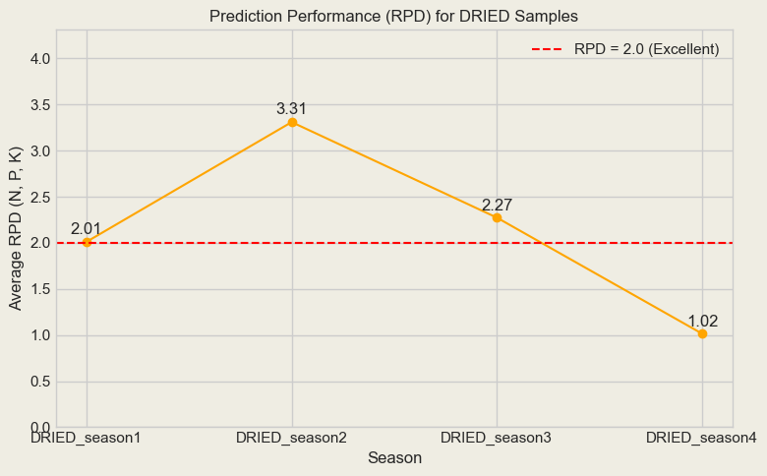
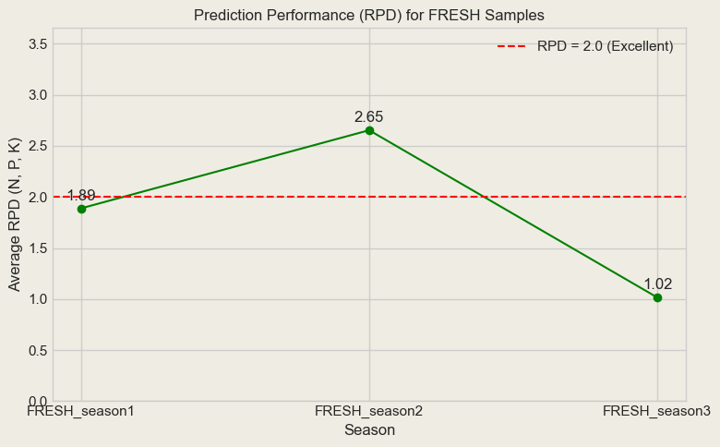
Validation Results
Results of Stacking PLS + Ridge Regression
Understand the Data
Data Preprocessing
Model Selection and Training
Validation Results
Parameters Setting
Dataset | Season | PLS Comp | Ridge α
DRIED | Season 1 | 10 | 10
DRIED | Season 2 | 10 | 0.1
DRIED | Season 3 | 10 | 10
DRIED | Season 4 | 10 | 10
FRESH | Season 1 | 5 | 10
FRESH | Season 2 | 10 | 0.1
FRESH | Season 3 | 10 | 0.1
Insights:
RPD > 2 indicates good model performance → mainly in Season 2
Fresh samples show more fluctuation → harder to model
Highlights the need for season-aware modelling and better handling of variability
Notes:
D
60s
Revise>>>
Results: Cross-Season Generalisation
Problem: Models trained on one season perform poorly on others.
Evidence: Cross-Season Heatmap (small)
(Show heatmap here – very quick explanation)

Slide 12
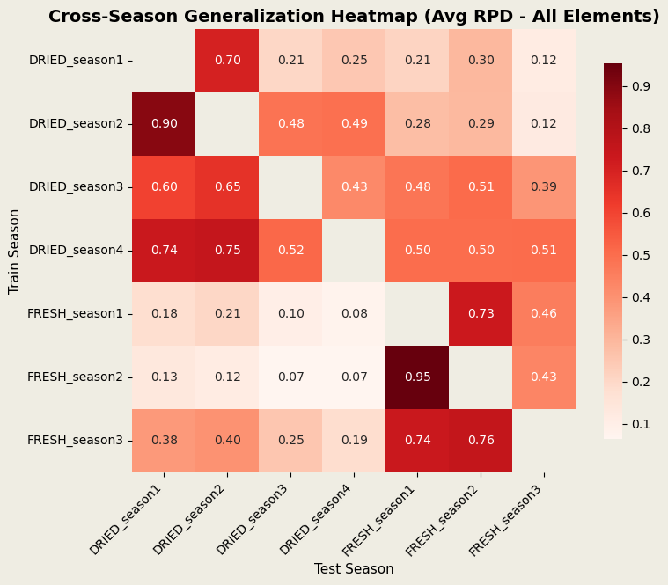
Validation Results
Results of Cross-season Generalisation
Understand the Data
Data Preprocessing
Model Selection and Training
Validation Results
Cross-Season Generalisation Heapmap(AVG RPD- All Elements)
Observations:
Weak overall generalisation ability
Significant performance differed between dry and wet seasons
Confirmed by the elements in the previous heat map
Insights:
The differences in spectral characteristics and element concentrations in different seasons make the model difficult to adapt to changes in different seasons.
Notes:
A
30 sec
Revise>>>
Results: Cross-Season Generalisation
Problem: Models trained on one season perform poorly on others.
Evidence: Cross-Season Heatmap (small)
(Show heatmap here – very quick explanation)

Slide 13
Further Work and Improvement
Data Augmentation
Current Challenge: Local shift and mix-up may disrupt spectral patterns, limiting its effectiveness
Future Work: Explore more realistic methods to enhance generalistion
Random Forest Tuning
Current Challenge:
PLS + Ridge suits linear patterns, struggles with non-linear
Random Forest is resource-intensive to run effectively
Future Work: Use better hardware or powerful cloud services to get better nonlinear relationships by integrating random forests
Notes:
1min
After what we've done above, there are still some part we want to imporve
Date Augmentation : First, data augmentation. We have tried several methods like Mixup and local spectral shift, but they didn’t really work well with our spectral data — they might distort the relationship between the features and the nutrient values. So we plan to try approaches that better represent the physical nature of the data.
Random Forest : Since both PLSR and Ridge focus on linear patterns, they might not work well for some nutrients in our dataset that involve non-linear relationships. That’s why we explored Random Forests, which are more flexible when it comes to handling non-linear patterns. We tried fast tuning methods when we first explored Random Forests, they showed relatively stable performance. However, the computational cost of grid search was too high, so we weren’t able to complete it fully. In future work, combining Random Forest with smarter tuning strategies and better hardware might help in improving prediction results.

Slide 14
Conclusion
What we have achieved:
Our team developed a nutrient estimation pipeline using spectral data from potato plants
Stacking PLS and Ridge Regression showed promising predictive performance
Our approach performed reasonably well across multiple seasons for key macronutrients (N, P, and K)
Real-world Implication:
May enable non-destructive, fast, and cost-effective nutrient monitoring
Has the potential to support decision-making in precision agriculture and smart fertilisation strategies
Notes:
A
20s
In conclusion, this project shows that stacking Ridge and PLS can effectively model nutrient levels in potato plants from spectral data. The approach that our group chose is efficient and practical, with potential for real-world use in precision agriculture. While further refinement is needed, the results of our project provide a foundation for data-driven, non-invasive nutrient monitoring.

